Slide 1
React Js Overview
React is a popular JavaScript library for building user interfaces. It allows you to create reusable UI components and efficiently manage the state of your application.
Pre-Request ⇒ Basic (HTML, CSS,JS)
Example on Html css and javascript

Slide 2
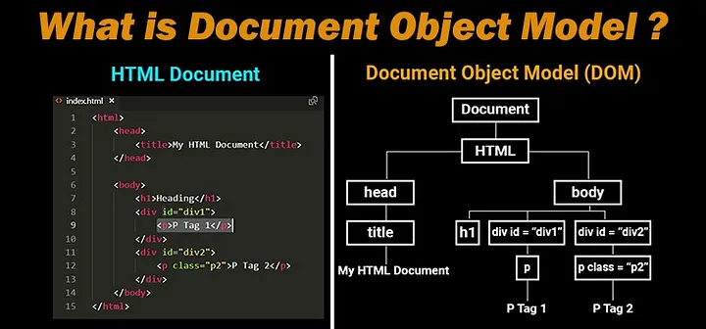
DOM (Document Object Model)
The DOM represents the structure of a web page as a tree-like structure, with each node in the tree representing an element, attribute, or text within the document.
The DOM provides a way to programmatically access and manipulate the elements and content of a web page.
It allows developers to dynamically modify the structure, content, and styling of a document, and also enables event handling and interactivity.

Slide 3
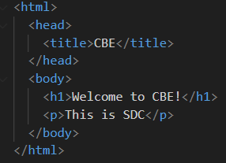
CONT…
The structure of this HTML document can be represented as a tree, with the `<html>` element serving as the root, the `<head>` and `<body>` elements as branches, and the `<title>`, `<h1>`, and `<p>` elements as leaves.

Slide 4
Virtual DOM
The Virtual DOM is a concept used in some JavaScript libraries and frameworks, like React. It is an abstraction layer on top of the actual DOM.
Instead of directly manipulating the real DOM, these libraries create a virtual representation of the DOM in memory, known as the Virtual DOM. When there are updates to the application state or data, the Virtual DOM is modified accordingly.
After the updates are made to the Virtual DOM, a process called "reconciliation" is performed. During reconciliation, the Virtual DOM is compared with the previous Virtual DOM state to identify the minimal set of changes required to update the real DOM.
Notes:
This process is optimized to minimize the number of actual DOM manipulations, which can be costly in terms of performance.
Once the minimal set of changes is determined, the libraries apply these changes to the real DOM, updating only the necessary elements. This approach helps to optimize performance by reducing the number of direct DOM manipulations and improving efficiency.

Slide 5
Set Up Your Development Environment
Before you start coding with React, you need to set up your development environment.
Node.js: Install Node.js, which includes the Node Package Manager (NPM). You can download it from the official Node.js website (https://nodejs.org).
Code Editor: Choose a code editor of your choice. Some popular options are Visual Studio Code, Sublime Text, or Atom.
Notes:
Visual Studio Code IS my favourite code editor

Slide 6

Create a New React Project
Create a new directory for your project:
Initialize a new React project using Create React App
Notes:
Once your development environment is set up, you can create a new React project. Open your terminal or command prompt and follow these steps:
Note the dot at the end of the command, which tells Create React App to set up the project in the current directory.
Create React App is a popular tool and development environment for creating React applications.
The npx command ensures that the latest version of Create React App is downloaded and used for setting up the project. It allows you to create a new React application without having to install Create React App globally.
But when you use npm it needs further steps 1. npm install -g create-react-app 2. create-react-app my-app

Slide 7
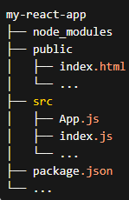
Explore the Project Structure
The public directory contains the HTML file that serves as the entry point for your application. The main file is index.html, where you can modify the title or add additional scripts or stylesheets if needed.
The src directory is where you'll write most of your React code. The App.js file is the main component of your application.
The index.js file is the entry point for your React application. It renders the App component and attaches it to the HTML file.

Slide 8
Create Your First React Component
Example
Notes:
In the gitignore if you want to put src/index.js

Slide 9
React Components
Example
Components are the building blocks of user interfaces.
They are reusable, self-contained pieces of code that encapsulate a specific functionality or UI element.
Components allow you to divide your user interface into smaller, manageable parts, making it easier to develop and maintain complex applications.
Notes:
There are two types functional and class components but we focus on class components

Slide 10
Props(properties)
Example
props (short for properties) are a way to pass data from parent components to child components.
Props are used to customize and configure components, allowing you to create reusable components with dynamic behavior.
Notes:
Using a separate function like handleClick instead of directly calling props.handleClick within the onClick event allows you to perform additional operations or manipulate the data before invoking the function passed as a prop. It provides a level of abstraction and flexibility for the child component to handle the click event in its own specific way.
You could also directly call props.handleClick within the onClick event if you don't need to perform any additional operations or manipulate the data before invoking the function. However, by using a separate function, you have the flexibility to add more functionality to the child component's click event handling if needed in the future.

